Slide 1
CREDIT EDA ASSIGNMENT
Muniba Naushad​

Slide 2
BUSINESS OPPORTUNITIES ARE LIKE BUSES. THERE'S ALWAYS ANOTHER ONE COMING.
“
”
Richard Branson

Slide 3
PROBLEM STATEMENT
The loan providing companies find it hard to give loans to the people due to their insufficient or non-existent credit history. Because of that, some consumers use it to their advantage by becoming a defaulter.
When the company receives a loan application, the company has to decide for loan approval based on the applicant’s profile.
Two types of risks are associated with the bank’s decision:
If the applicant is likely to repay the loan, then not approving the loan results in a loss of business to the company
If the applicant is not likely to repay the loan, i.e. he/she is likely to default, then approving the loan may lead to a financial loss for the company.

Slide 4
OBJECTIVE
To identify patterns which indicate if a client has difficulty paying their instalments which may be used for taking actions such as denying the loan, reducing the amount of loan, lending (to risky applicants) at a higher interest rate, etc. through different driver variables behind loan default, i.e. the variables which are strong indicators of default.
To use EDA to analyze the patterns present in the data. This will ensure that the applicants capable of repaying the loan are not rejected.
The company can utilize this knowledge for its portfolio and risk assessment. This will ensure that the consumers capable of repaying the loan are not rejected.

Slide 5
DATA
The data contains the information about the loan application at the time of applying for the loan. It contains two types of scenarios:
The client with payment difficulties: he/she had late payment more than X days on at least one of the first Y instalments of the loan in our sample,
All other cases: All other cases when the payment is paid on time.

Slide 6
DATA UNDERSTANDING
This dataset has 3 files as explained below:
1. 'application_data.csv' contains all the information of the client at the time of application. The data is about whether a client has payment difficulties.
2. 'previous_application.csv' contains information about the client’s previous loan data. It contains the data on whether the previous application had been Approved, Cancelled, Refused or Unused offer.
3. 'columns_description.csv' is data dictionary which describes the meaning of the variables.

Slide 7
APPROACH
Data Cleaning
Columns having more than 45% missing values were removed.
Then columns that seemed irrelevant for analysis were identified and dropped.
Missing Values Treatment
Category type columns were imputed with most frequent values.
Numerical columns were imputed with median as the outliers were detected.
Outliers
Outliers were detected , in some of the columns, outliers could be present due to data mis-entry and would require further analysis.
Suggesting, to treat with the upper or lower limit values in numerical column types.

Slide 8
APPROACH
Data Standardization
Ensuring all observations under one variable are expressed in a common and consistent unit.
Some of the observational columns like flag type with 0 and 1 values were converted to categorical type to be represented as ‘yes’ and ‘no’ for better visualization.
Binning
Created bins/range for certain columns like Age, Income Total, Family status for better visualization and reaching meaningful insights.

Slide 9
APPROACH
Data Cleaning
Columns having more than 45% missing values were removed.
Then columns that seemed irrerelevant for analysis were identified and dropped.
Missing Values Treatment
Category type columns were imputed with most frequent values.
Numerical columns were imputed with median as the outliers were detected.
Outliers
Outliers are replaced with the upper or lower limit values in numerical column types.

Slide 10
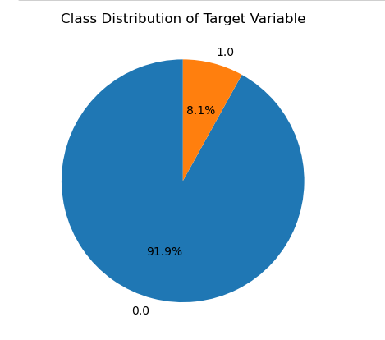
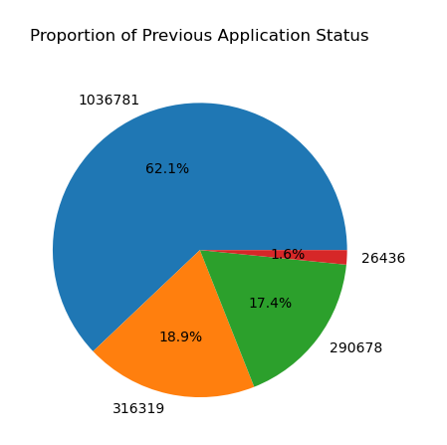
INSIGHTS
Target data is not balanced, only 8% clients are shown who defaults.
Almost 62% applications are approved in previous application data and 18% and 17% are Cancelled and refused respectively.

Slide 11
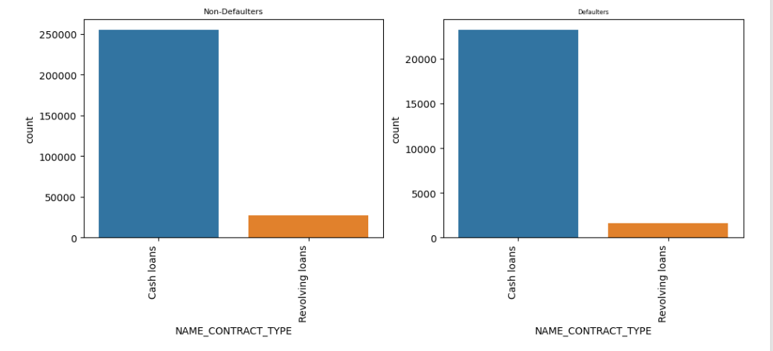
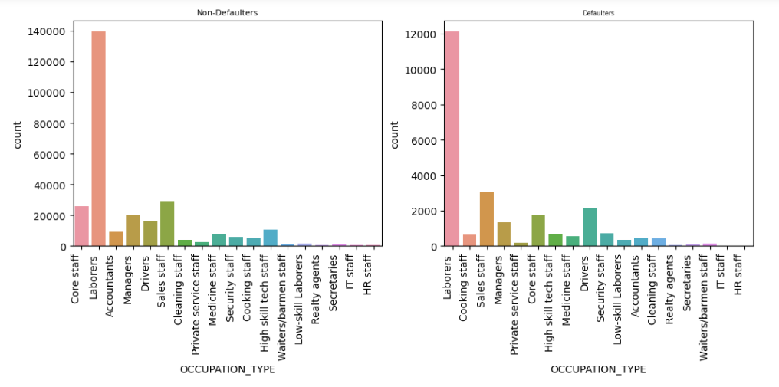
INSIGHTS
Cash loan Contract type clients are majorly doing defaults compared to Revolving loan type
Unskilled citizens or laborer are taking more loans than skilled clients like Managers, Accountants etc.

Slide 12
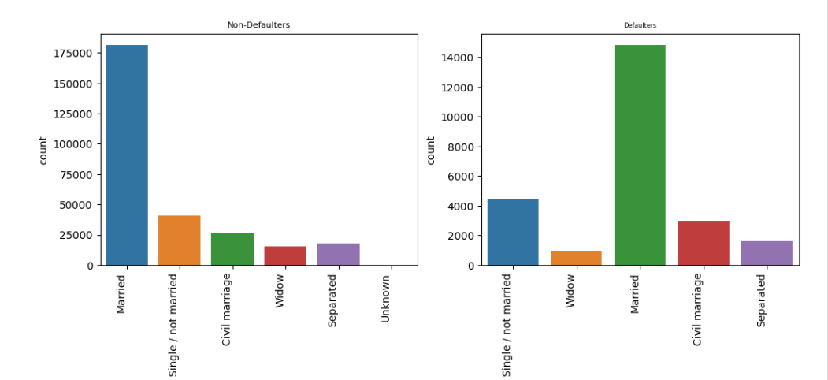
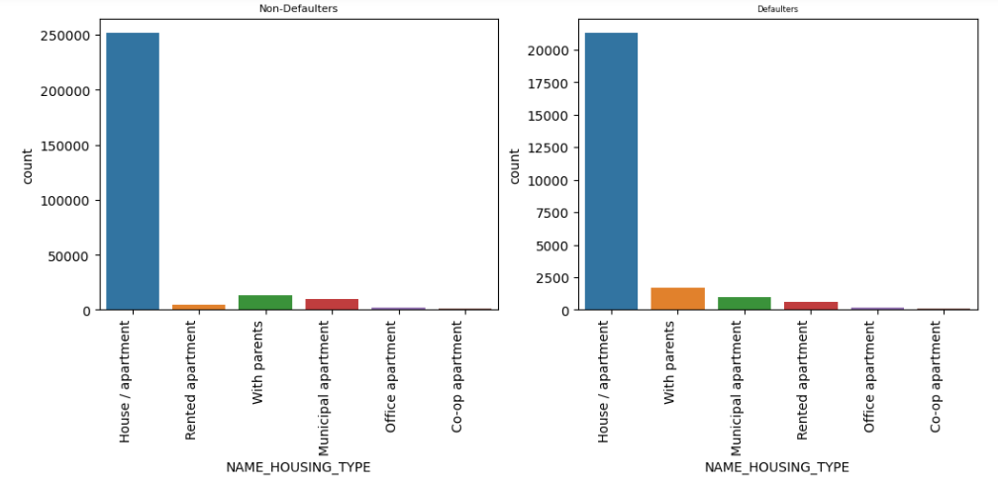
INSIGHTS
Married clients are doing more default compared to Single or Unmarried.
Clients who owns house/apartment are doing more default compared to other categories

Slide 13
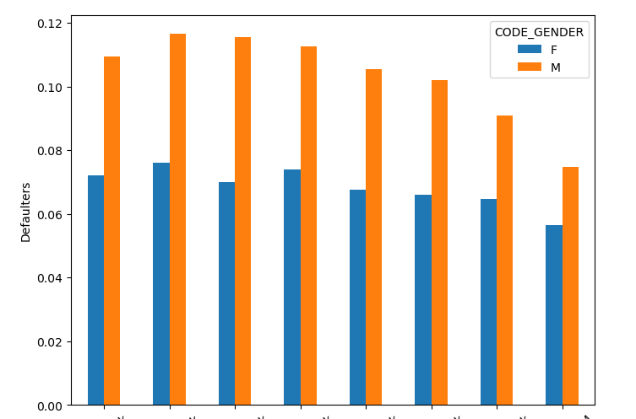
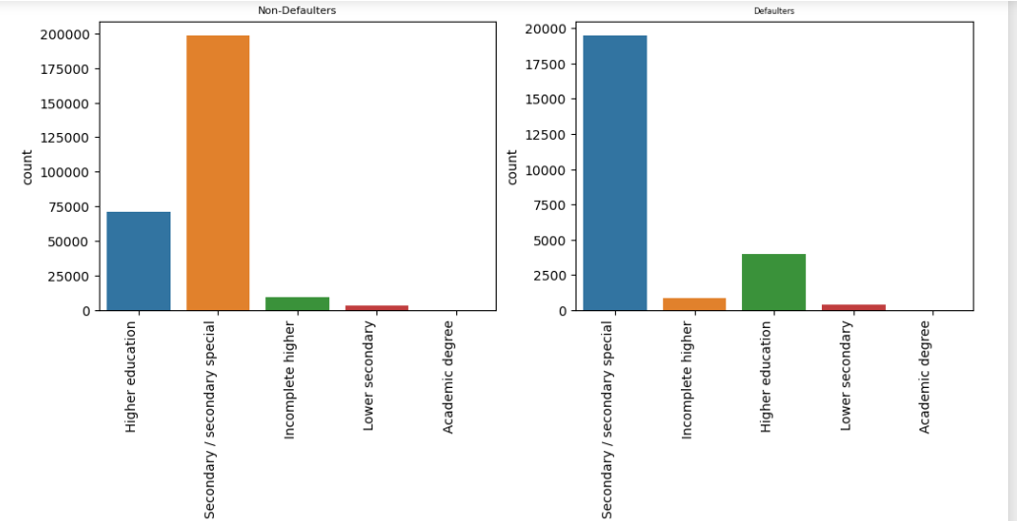
INSIGHTS
Male candidates are facing more payment difficulty as compared to females.
Secondary Educated type clients are the maximum who have payment difficulties Clients who owns house/apartment are doing more default compared to other categories

Slide 14
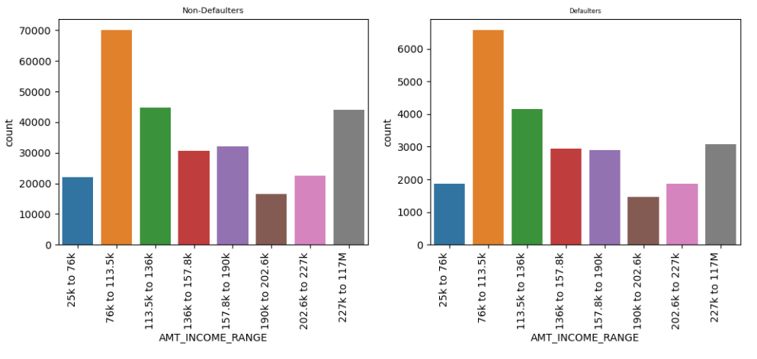
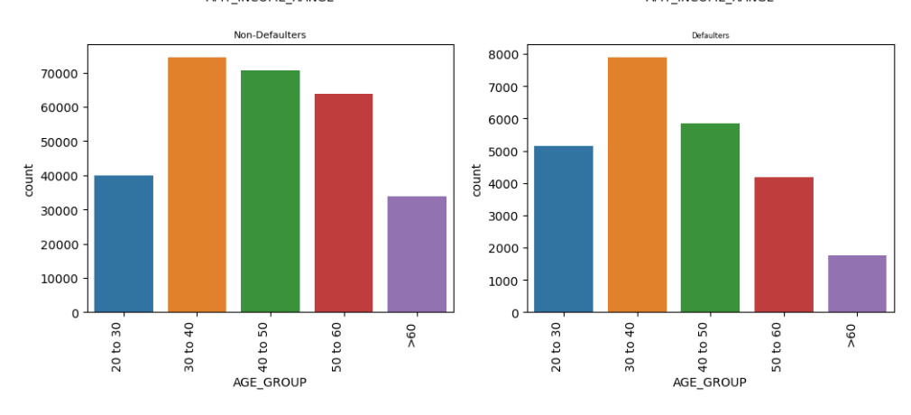
INSIGHTS
Clients with income range medium to high are more keen towards taking loans.
Young clients of age group 30-40 are having more payment difficulties

Slide 15
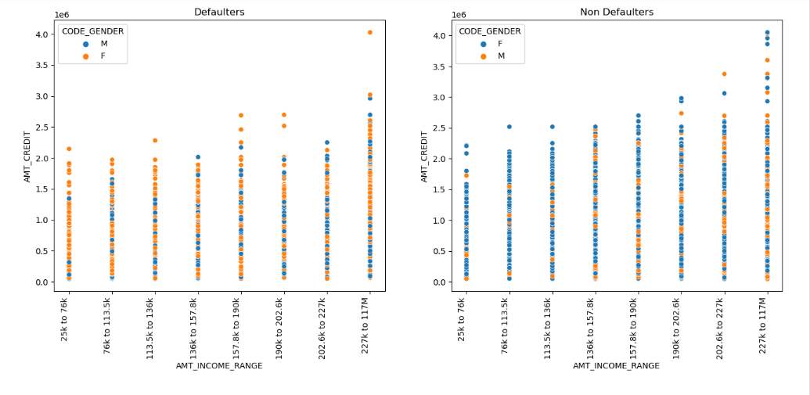
INSIGHTS
We observed that amount credit or loan is increased as the income increased, for both the genders

Slide 16
SUMMARY
Factors indicating possibility of loan default:-
Education level : Less educated people are more likely to default their loan.
Occupation : Unemployed, unskilled staff like labors, cleaning staff and people with less stable jobs are more likely to default.
Loan history: Applicant whose previous loans are refused/cancelled are more likely to default their loan.
Loan frequency: Frequent borrowers are also more likely to default

Slide 17
THANK YOU
Mirjam Nilsson​
mirjam@contoso.com
www.contoso.com

